Slide 1


Summary of
Data Analysis

Slide 2


Today's agenda
Project recap
Problem
The Analytics team
Process
Insights
Summary

Slide 3

Social Buzz is a fast growing technology unicorn that need to adapt quickly to it's global scale. Accenture has begun a 3 month POC focusing on these tasks:
An audit of Social Buzz's big data practice
Recommendations for a successful IPO
Analysis to find Social Buzz's top 5 most popular categories of content
Project Recap

Slide 4


Problem
A lot of data being generated from the use of the social media and this needs to have proper planning to capitalize on it.
Analysis to find Social Buzz's top 5 most popular categories of content

Slide 5



The Analytics team

Slide 6
Process
1
Data collection and Understanding
2
Data Cleansing
3
Data Modelling
4
Data Analysis
5
Data visualization and insights

Slide 7

Insights
16
Unique Categories
1897
Reactions to
Animals
Most reactions
In January

Slide 8
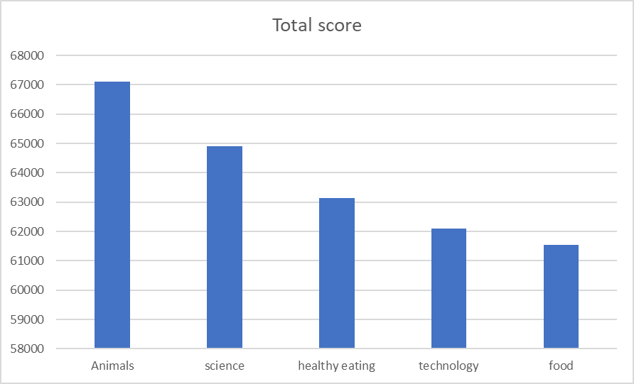
TOP 5 Categories

Slide 9

ANALYSIS
Animals and science are the two most popular categories of content, showing that people enjoy nature and try to understand it.
Summary
Conclusion
Food and healthy eating are popular, Social buzz should consider approaching more restaurants and fitness companies and bring more attention to the website and there could be an increase in user engagement resulting in smore sales

Slide 10

Thank you!
ANY QUESTIONS?

